Slide 1
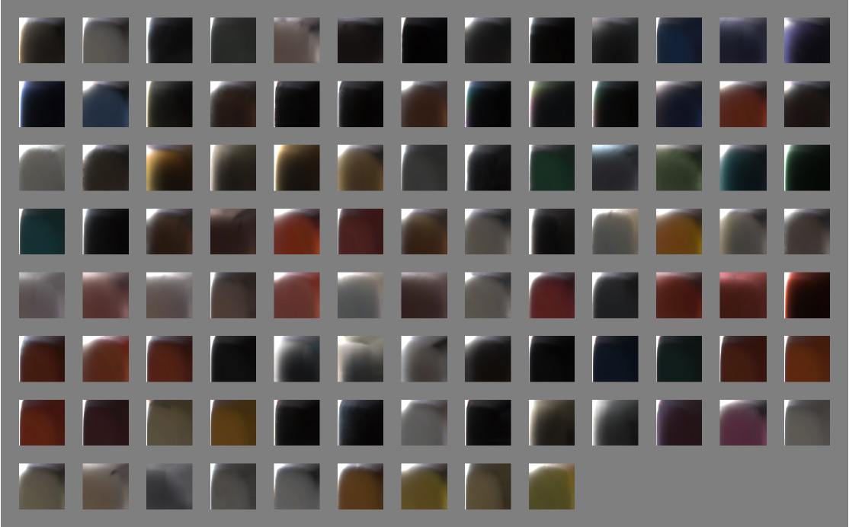
Beginners guide to Physically Based Rendering
Everything is shiny

Slide 2

Where is PBR used?
- Generated graphics with material properties
- CG animated movies - eg Disney / Pixar
- Computer games - realtime
- CAD and different type of realtime visualizations
- Photorealistic rendering (raytracing)
- In short: Whenever there is a need for material properties

Slide 3
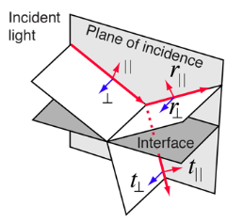
- What is PBR?
- A model of how to render material properties in computer graphics
- Illumination of objects in a scene - color of the pixels in the image
- Common way to describe how light behaves in different mediums
- Reasonable approximation of how light behaves in real world
- Based on Fresnel’s equations for reflection and refraction

Slide 4

Light
- Light moves in a straight line
- Changes direction when the refractive index of interfaces change
- Lower (grazing) angles have higher probability of reflecting light
- Materials may appear mirror like at lower incidence – eg water
- Light is reflected or refracted on the surface
- Material may absorb light – ie refracted light does not leave surface
- Metals – reflects or absorbs light
- Insulators – reflects, refracts or absorbs light

Slide 5
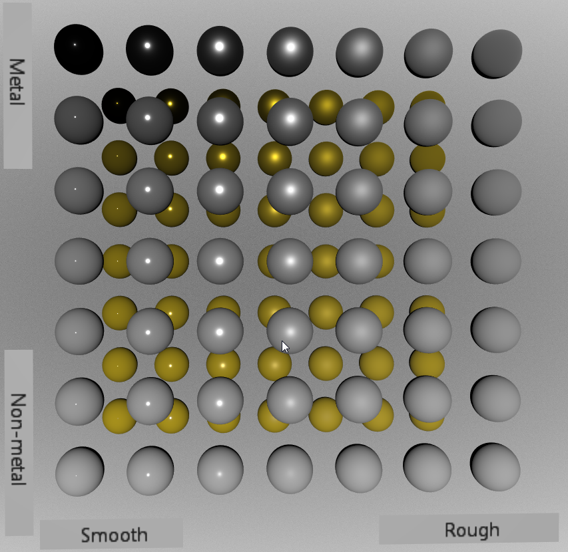
Common properties for PBR
- Needs to be physically correct – for the most part
- Energy conserving – outgoing light <= incoming light
- Follow Helmholtz reciprocity principle – emitter and detector can swap
- Microfacet based BRDF
- Two major material properties:
- Conductive (metal) or insulator (dielectric)
- Roughness of surface

Slide 6
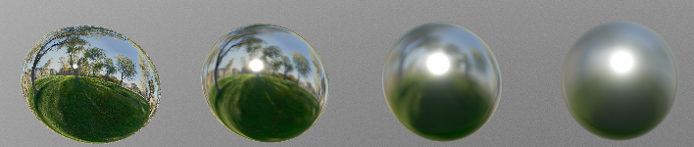
Microfacet theory
- Surfaces may have bumps bigger than light wavelength but invisible
- Points on the surface reflects, and refracts, light in different directions
- Subsurface scattering within sampled shading area (pixel)
- Aggregate the result of reflections and refractions
- Material appears smooth but gives blurry reflections - roughness

Slide 7
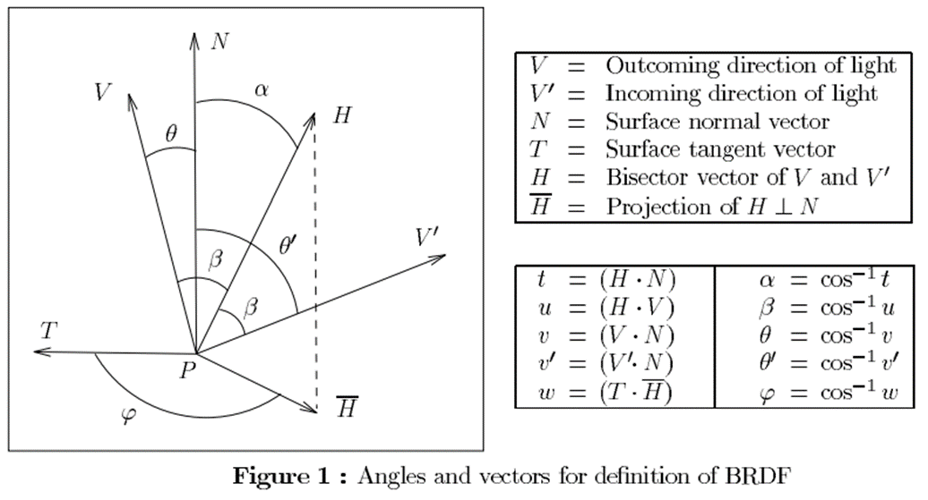
BRDF – The heart of Physically based rendering
- Bi-directional Reflectance Distribution Function
- Describes how light reflects on an opaque surface
- Surface reflection ratio using Fresnel equation
- Normal distribution function and geometric occlusion
- Calculate reflected light using Light + View vector

Slide 8

Fresnel
- Optimization of Fresnel equation using albedo color and ‘metalness’
- F0 = material reflection at zero incidence
- Surface reflection F = F0 + (1 – F0) * (1 – V dot H) ^5 - Fresnel Schlick

Slide 9
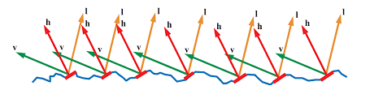
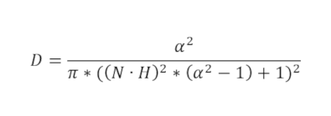
Normal Distribution Function
- Each microfacet reflects light in only one direction (perfect mirror)
- Outgoing direction depends on normal (m) and light direction
- Only microfacets with normal at h (m=h) will reflect any visible light
- Contributes to the specular highlights
- Trowbridge-Reitz
Alpha = roughness ^ 2

Slide 10
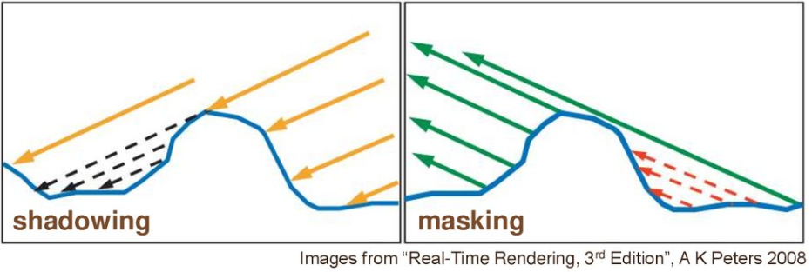
Geometric Occlusion - Visibility term
- Not all microfacets will contribute due to blocking by other microfacets
- Shadowing if incoming light is blocked by microgeometry
- Masking if outgoing light is blocked by microgeometry
- BRDF ignores possibility of multiple surface bounces
- Gives a darkening effect

Slide 11
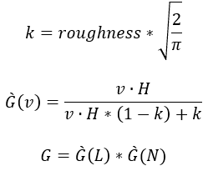
Schlick’s geometric occlusion
L = Light vector
N = Surface normal

Slide 12
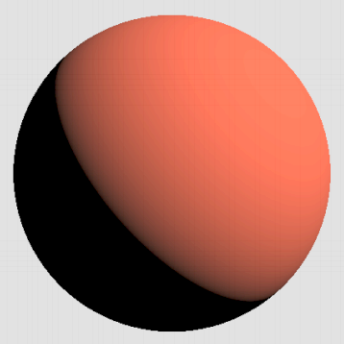
Diffuse term – subsurface reflection
- Lambert model – constant value
- Simplified to only depend on light and normal vector – NdotL
- Refraction is light that is not reflected - since we have Fresnel:
- Diffuse = (1 – Fresnel) * diffuseColor / PI
- Where diffuseColor depends on metallic value
- More complex models take roughness into account

Slide 13
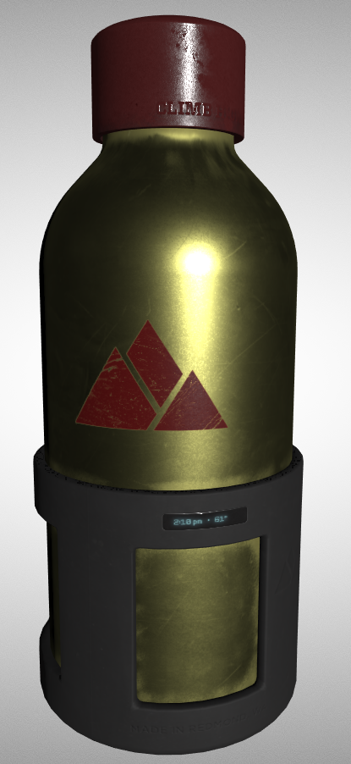
Resulting lighting equation
- Both specular and diffuse term depends on incoming light direction
BRDF(l,v) = (f_specular + f_diffuse) * light(r,g,b) * NdotL
f_specular = Fresnel * Distribution * Visibility
f_diffuse = Diffuse

Slide 14
What’s next?
- GLTF 3D file format by Khronos group
- https://github.com/KhronosGroup/glTF/blob/master/specification/2.0
- Java opensource implementation: https://github.com/rsahlin/graphics-by-opengl

